Slide 1

HISTORY OF THE EMERGENCE OF INDEPENDENT BANGLADESH
Dr. Md. Abdul Alim
B. A (Hon’s), M. A (History), M. Phil (Raj), Ph. D (Raj)
Email:doctorabdulalim64@gmail.com
Cell: +880 1718-787466

Slide 2
DISCUSSION CONTENTS
Pala Dynasty
Independent Kingdoms of South-east Bengal
Sena Dynasty
Social, Cultural & Economic Condition Of Ancient Bengal
Rivers & The Social-economic And Cultural Life Of Ancient Bengal

Slide 3
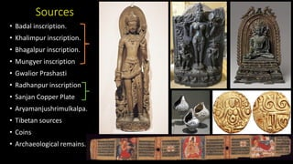
THE RISE OF PALA DYNASTY
The anarchy or Matsyanyayam and confusion that prevailed for more than a century led to a natural reaction. The people, who had suffered untold miseries for a long period, suddenly developed a political wisdom that impacted positively the establishment of the Pala dynasty. They perceived that the establishment of a single strong central authority was the only effective remedy against political disintegration. They also realized that such a happy state of things could only be brought about by the voluntary surrender of authority to one person by the numerous petty chiefs who had been exercising independent political authority in different parts of the country. This process of transition ended through a bloodless revolution which made a popular local hero Gopala the elected king of the country. This event is recognized as one of the first democratic elections (?) in South Asia since the time of the Maha Janapadas.

Slide 4
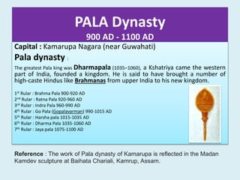
THE RISE OF PALA DYNASTY
The rule of the Pala dynasty started in the middle of the eighth century which introduced a new era in Bengal history. For the first time, we observed a long-lasted single ruling dynasty in Bengal.
Pala, they ruled Bengal and Bihar from 760 – 1142 A.D. About 4 kings. They are; 1. Gopala 2. Dharmapala (son) 3. Devapala (son) 4. Mahipala I Gopala, Dharmapala and Devapala were relatd on family tree. But we couldn’t find any source that relates Mahipala I to that family tree
Though this memorable episode in the history of Bengal is known to us only in a brief outline. According to Khalimpur Copperplate: ‘'His son was the crest-jewel of the heads of kings, the glorious Gopala, whom the people made take the hand of fortune, to put an end to the practice of fishes’’. It is clear from the above description that the Gopala was made as a king to restore peace and prosperity to the country. However, in which way he was elected and who are the people who elected him, is highly debatable. According to R.C Majumder, this group of people, whom we know as Prakriti Punja were a group of nobles who elected Gopala as their chief. This decision was perhaps subsequently endorsed and acclaimed by the people.

Slide 5
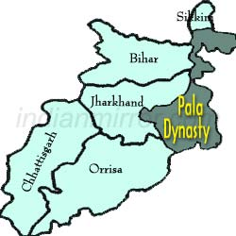
THE RISE OF PALA DYNASTY
By electing Gopala to the throne of Bengal the leading persons of Bengal of that time had given proof of their sense of nationalism and patriotism. Gopala’s first task was the removal of lawlessness and disorder from the country which he did without any delay and thereby fulfilled the expectation of the people of Bengal. His reign was occupied largely by war to bring peace and to protect the country from foreign invasions. His efforts were crowned with success and Bengal enjoyed a period of peace and prosperity. Although much is not known about his reign, it is believed that he brought the whole of Bengal under his control. The exact length of his reign is also not known.

Slide 6

GOPALA (REIGN: 750 – 770 AD)
Nothing special can be known about the earlier life of Gopala. Nothing clear is also known about the identity of the Pala dynasty and their original abode. The father's name of Gopala was Byppot. He was a 'destroyer of the enemy'. His grandfather was Doitovishnu. No royal title was seen before their names. So, it is thought that they were ordinary persons. Doitovishnu was 'pure of all knowledge'. It appears from this perspective that Gopala was known as a skilled warrior like his father. The Pala reign began in Bengal with Gopala's ascending to the throne. The kings of the Pala dynasty ruled this country for 400 years.
Gopala paid attention to extending his kingdom. He brought nearly the whole region of North and east Bengal under his rule. South-east Bengal remained beyond the rule of Gopala. Many opine that Gopala reigned for 27 years. But the modern researchers think that he ruled the country from 756 A.D. till 781 A.D.

Slide 7

DHARMAPALA (REIGN: 770 – 810 AD) After the death of Gopala, Dharmapala (781A.D. -821A.D.) came to the throne of Bengal. He was the most famous and established the rule throughout Bengal and Bihar.
At that time a competition was going on among the three dynasties to exercise domination in North India. One was the Pala dynasty of Bengal, the other was the Gurjarpratihara of Rajputana, and the third one was the Rashtrakutas of the Deccan.
In history, this fight is known as 'the Tripartite struggle'. The first fight took place between Dharmapala and Vatsaraja belonging to the Protihara dynasty. Though Dharmapala was defeated he conquered quite several regions beyond Bengal. He extended his kingdom to the region between the Ganges and the Jamuna, conquering Varanasi and Proyaga. Though Dharmapala was defeated at the start of the tripartite struggle, he did not suffer much harm because, after the conquest, Rastrokutraja returned to the Deccan. Taking this advantage, Dharmapala occupied Kanauj. But within a short period, the king of Protihara Nagvhatta occupied Kanauj. As a result, there was a fight between him and Dharmapala. At this time Dharmapala did not suffer any loss. Because as before the king of Rastrokutaraja Govinda came to north India and defeated Nagvhatta. After the defeat of the king of Pratihar, Dharmapala also surrendered to Govindha. After that when the king of Rastrokut returned to his country, Dharmapala again got the opportunity of extending his domination.

Slide 8
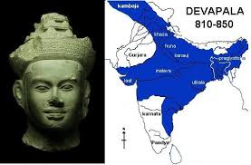
DEVPALA REIGN:821– 861 AD & OTHERS
After the death of Dharmapala, his son Devapala (821A.D.-861 A.D.) came to the throne. Like his father, he was able to expand the kingdom. Devapala directed successful military expeditions against the kings of Pratihara and the Rastrakuta in northern India. He occupied a large region of northern India. After all, it was his time when the Pala kingdom expanded the most. Devapala was a great patron of Buddhism. He repaired the Buddhist monasteries of Magadha. He built a monastery in Nalanda and an enormous temple. Devapala was very respectful of learning and the learned. Under the patronization of Devapala, Nalanda University then became the main center of Buddhist culture in the whole of Asia. Buddhism was active again in northern India centering around Nalanda University during his rule which was nearly lost. Since the death of Devapala, the fall of the Pala empire started. After his death, some chicken-hearted and good-for-nothing inheritors came to the throne. They could not keep up the glory and power of the Pala empire. As a result, the Pala empire gradually marched towards downfall.
Mahipala I: 988 AD. Recovered northern and eastern Bengal. Also took Bihar.
Ramapala: The last strong Pala king. The kingdom disintegrated during his son Kumarapala’s reign.
Madanapala (Reign: 1144 – 1162 AD): After him, the Sena dynasty replaced the Palas. The 18th ruler of the Pala dynasty and general is considered the last ruler but he was succeeded by Govindapala though this name is questionable.

Slide 9
INFLUENCE OF PALA DYNASTY
Gopala founded the dynasty in 750 AD;
He was a chieftain or military general who was elected as king by notable men of the area to prevent anarchy.
The Pala empire was an Imperial power during the late classical period in the Indian subcontinent, which originated in the region of Bengal (modern day Bangladesh and West Bengal).
It is named after its ruling dynasty, whose rulers bore names ending with suffix of Pala (“protector” in Sanskrit).
The empire was founded with the election of Gopala as the emperor of Gaura in 750 AD.
The Pala stronghold was located in Bengal and Bihar, which included the major cities of Vikrampura, Patliputra, Gaura, Somapura, Ramavati (Varendra), Tameralipta and Jaggadala.
The Palas were introduced diplomats and military conquerors.
Their army was noted for its vast war elephant corps.
Their Navy performed both Mercantile and defensive roles in Bay of Bengal
They built grand temples, including the Somapura Mahavihara and the great universities of Nalanda and Vikramsheila

Slide 10
LEGACY OF THE PALA DYNASTY
During this time, The Pala Empire was dethroned by the Hindu Sena dynasty in the 12th century.
The Pala period is also known as a ‘Golden Era’ in Bengali history.
They built magnificent monasteries and temples: Somapura Mahavihara (in Bangladesh), and Odantapuri Monastery.
They also patronized Buddhist centers of learning like Nalanda University and Vikramshila University.
The Bengali language developed. The first Bengali literary Charyapada is attributed to this period.
Many Buddhist teachers from the Pala kingdom traveled to Southeast Asia to spread the faith.
Sanskrit scholars were also patronized by the Pala kings.
The Pala art (art seen in Bengal and Bihar during the Pala regime) influence is seen in the art of Nepal, Sri Lanka, Burma, and Java.

Slide 11
DECLINE & ADMINISTRATION OF PALA DYNASTY
Decline
In the 9th century, the Pala empire was the dominant power in the northern Indian subcontinent, with its territory across parts of modern-day eastern Pakistan, northern and northeastern India, Nepal, and Bangladesh;
The empire reached its peak under emperors/Samrat Dharampal and Devapala;
The Palas also exerted a strong cultural influence under Atisha in Tibet and Southeast Asia.
Pala's control of North India was ultimately very poor times as they struggled with the Pratiharas and the Rashtrakutas for the control of Kannauj and were defeated.
Emperor Ramapala was the last strong ruler, who gained control of Kamarupa and Kalingga.
The Sena dynasty dethroned the Pala Empire in the 12th century, ending the reign of the last major Buddhist Imperial power in the Indian subcontinent.
Administration
The Pala rule was monarchial.
The King was the center of all power.
Pala Empire was divided into separate provinces (Bhuktis)
Provinces were divided into divisions (Vishayas) and districts (Mandalas).
Administration covered the widespread area from the grassroots level to the Imperial court.

Slide 12
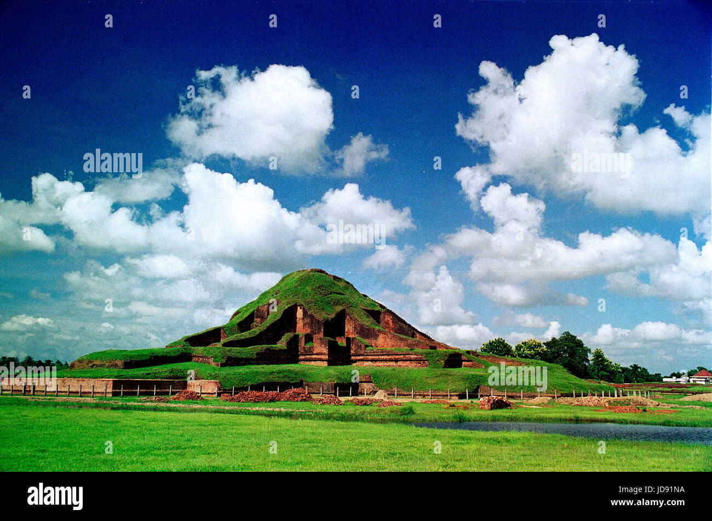
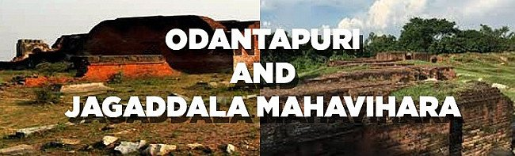
ARCHITECTURE PALA DYNASTY
Influenced by Gupta art, the Palas School of Art is recognized as a distinct face of Indian art and is noted for the artistic genius of the Bengals.
The Palas built several structures, including the Somapura Mahavihara in present-day Bangladesh a World Heritage site. It is a monastery with 21 21-acre (85000 meters square) complex that has 177 cells, numerous stupas, temples, and several ancillary buildings.
The gigantic structures of other Viharas, including Vikramshila, Odantpuri, and Jagaddala are the other masterpieces of the Palas.

Slide 13
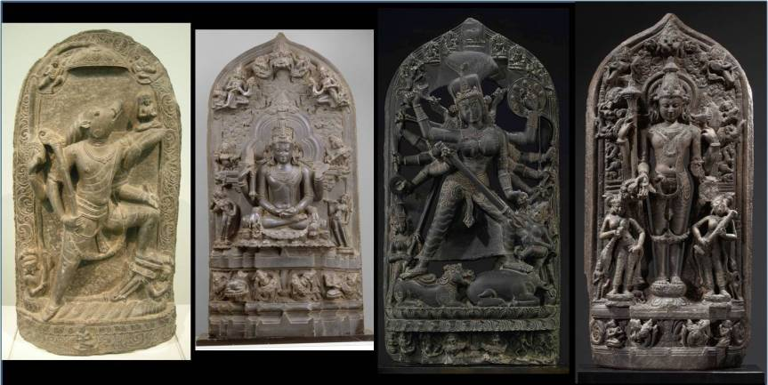
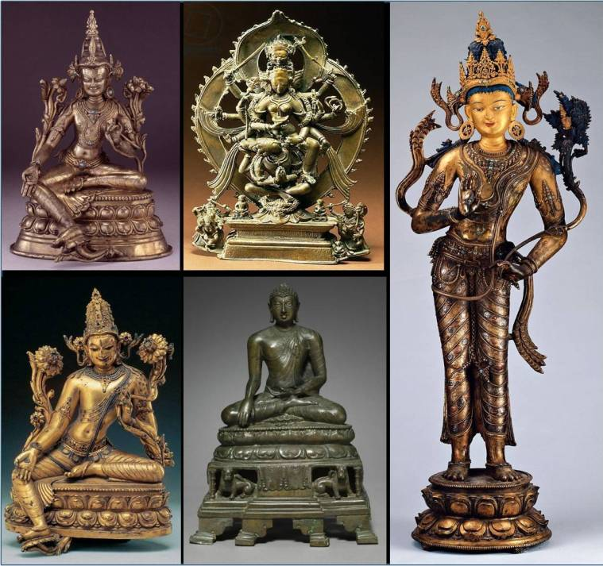
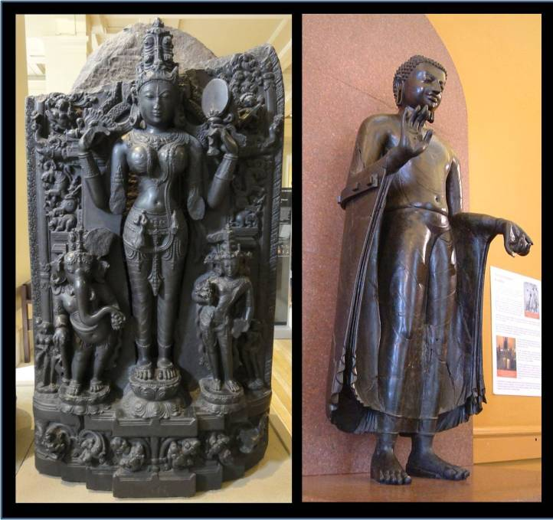
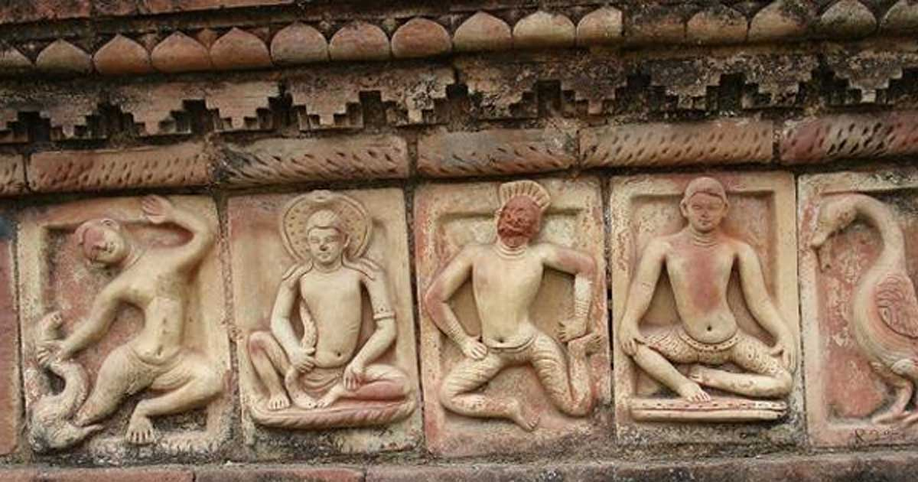
SCULPTURES OF PALA DYNASTY

Slide 14
CONTRIBUTION OF THE PALAS
Contribution of the Palas: The Pala Empire can be considered as the golden era of Bengal. Never had the Bengali people reached such height of power and glory to that extent. Palas were responsible for the introduction of Mahayana Buddhism in Tibet, Bhutan, and Myanmar. The Palas had extensive trade as well as influence in Southeast Asia. This can be seen in the sculptures and architectural style of the Sailendra Empire (present-day Malaya, Java, Sumatra). The Pala Empire eventually disintegrated in the 12th century weakened by attacks of the Sena dynasty followed by the invasion of Bakhtiyar Khilji's Muslim armies. We can discuss the contributions of the Palas from different aspects:
Political Contribution of the Palas: The empire reached its peak under Dharmapala and Devapala. Dharmapala extended the empire into the northern parts of the Indian Subcontinent. This triggered once again the power struggle for the control of the subcontinent. Both Dharmapala and Devapala were engaged in a long-drawn struggle for the possession of the madhyadexa of the northern Indian empire with two other powers - the Gurjara Pratiharas of western India and the Rastrakutas of Deccan, and they had success for a limited period. The Pala records are full of glorifying verses portraying Dharmapala and Devapala as great conquerors. Bengal came to be reckoned as a powerful force in northern Indian politics. The Tibetan historian Taranath has specifically mentioned that the empire of Dharmapala extended from the Bay of Bengal in the north to Delhi, Jullundhar, and Vindhyas to the south.

Slide 15
ADMINISTRATION OF PALA EMPIRE
Pala dynasty created its administration model based on the Gupta Empire’s administrative practices.
The Pala Dynasty had a monarchical administrative structure. All power was concentrated in the hands of the king or monarch.
Parameshwar, Paramvattaraka, or Maharajadhiraja were offered to the Pala rulers.
In the Pala dynasty, the throne was passed down through the generations.
The King was aided by a group of ministers who were hereditary and nominated by the King from prominent families.
Some provinces in the Pala Empire were under the direct rule of the King, while others were under the control of Vassal chiefs.
The regions governed by the Vassal chiefs were granted autonomy. They provided the King with fixed contributions and troops.
The Pala Empire’s lands that were managed directly were divided into many provinces known as Bhuktis and governed by officials known as Uparika.
Uparika collected the levy and preserved the province's law and order.
These Bhuktis (Provinces) were further segmented into Vishaya (Divisions) and Mandala (Districts).
Further, they were divided into smaller units like Khandala, Bhaga, Avritti, Chaturaka, and Pattaka.

Slide 16
INDEPENDENT KINGDOMS OF SOUTH-EAST BENGAL
South-east Bengal was independent during most of the periods of the Pala Age. Then this region was included in Banga 'Janapada'. From the middle of the eighth century, several kings of dynasties sometimes ruled their areas independently declaring revolt against Pala kings, and sometimes they would accept the submission of Pala kings.
The Kharga Dynasty: Subsequent kings belonging to the Gupta dynasty established their lordship in Magadha and Gaur in the second half of the seventh century. At this time the kings of the Kharag dynasty gave birth to an independent kingdom in south-east Bengal. Their capital was 'Karmanta Basaka'. Probably, 'Karmanta Basaka' is the ancient name of the Comilla district. The possession of the Kharags was extended to Tripura and Noakhali region.
The Deva Dynasty: After the rule of the Kharag dynasty there was the rise of the Deva dynasty in the same region at the start of the eighth century. We get the names of the four kings of this dynasty. They were Sree Santideva, Sree Beerdeva, Sree Anandadeva and Sree Bhabadeva. The Deva kings considered themselves very powerful. Their capital was Devaparbata. This Debparvaata was situated near Maynamoti in Comilla. The kingdom of the Devas was extended across the whole Samatata region. The Deva kings ruled supposedly from 740 A.D. to 800 A.D.

Slide 17
INDEPENDENT KINGDOMS OF SOUTH-EAST BENGAL
The Varma Dynasty: the Pala administrative power having become weak at the last phase of the eleventh century, a dynasty with the title 'Varma' shaped itself in south-east Bengal. He who laid the foundation in Banga was Brojovarma and his son Jaatvarma. He was also a feudal king of Gangeyodeva, the Kalochuri king, and Karna. During the Kaibarta revolt, he established an independent kingdom in Southeast Bengal with the help and support of his father-in-law, Karna, the Kolochuri king. The capital of the Varmas was in Bikrompura of Munshiganj district. After the time of Jatvarma, his eldest son Harivarma ruled for 46 years at a stretch. He was on good terms with the Pala kings. Salvarma was the last king of the Varma dynasty because, after the end of his reign, there was no account of his dynasty. Probably, in the middle of the 12th century, Bijoy Sena belonging to the Sena dynasty caused the decline of the Varma dynasty and introduced the rule of the Sena dynasty in Southeast Bengal.

Slide 18
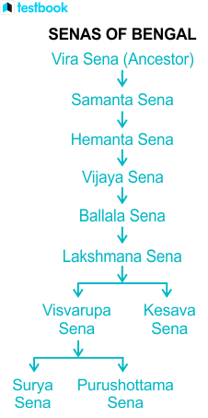
HISTORY OF SENAS OF BENGAL
Samanta Sena was the founder of the dynasty. Hemanta Sena usurped the throne, proclaimed himself king in 1095 AD, and came after him. His successor, Vijaya Sena, had an unusually long reign of more than 60 years and contributed to establishing the dynasty. Ballala Sena expelled the Pala from Gaur, took control of the Bengal Delta, and established Nadia as its capital. After succeeding Ballala Sena in 1179, Lakshmana Sena governed Bengal for almost 20 years. He expanded the Sena Empire to include Odisha, Bihar, and likely Varanasi. Ramadevi, a princess of the Western Chalukya Kingdom, was married to Ballala Sena. This shows that the Sena dynasty's rulers kept close social ties to South India.
Read More Deccan Kingdoms in Ancient India- Beginnings and Developments!
Before starting, let us look at the family tree of the Senas!

Slide 19
ORIGINS OF SANAS DYNASTY
The Sena rulers were Hindu Gaur Kayasthas. During this period, Buddhism, which had dominated Bengal for centuries, was in decline, due to the loss of Buddhist institutions at Nalanda University and Vikramshila University. The Sena rulers were originally from Karnataka and spoke the Karn deopara inscription.
The Sen rulers
Hemanta Sen (1070–1096 AD)
Vijay Sen (1096–1159 AD)
Ballal Sen (1159–1179 AD)
Lakshman Sen (1179–1206 AD)
Vishwarup Sen (1206–1225 AD) Keshab Sen (1225–1230 AD)

Slide 20
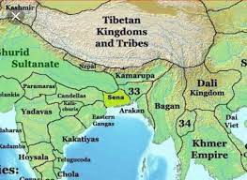
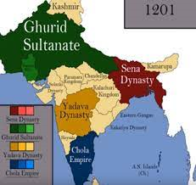
MAP OF SENA DYNASTY

Slide 21
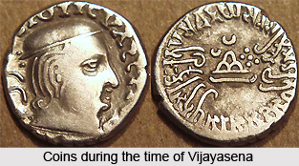
SENA DYNASTY
Following the Palas, the Sena family ruled Bengal. Hemantasena, the son of Samantasena established an independent principality. Samantasena, its founder, was referred to as a "Brahmakshatriya.". Samantasena was identified as a Brahmakshatriya. But his successors referred to themselves as Kshatriyas only. Let us look at them.
Vijayasena
Vijayasena, the son of Hemantasena, made the family famous during his lengthy rule of more than sixty years. Vijayasena, who started as a small ruler, almost conquered all of Bengal to lay the groundwork for his family's future supremacy.
The renowned poet Sriharsha wrote the Vijayaprasasti in honor of Vijayasena. Vijayasena took on the imperial titles Paramesvara, Paramabhattaraka, Maharajadhiraja, and others. He had two capitals, one in Bangladesh at Vikramapura and the other in West Bengal at Vijayapuri.

Slide 22
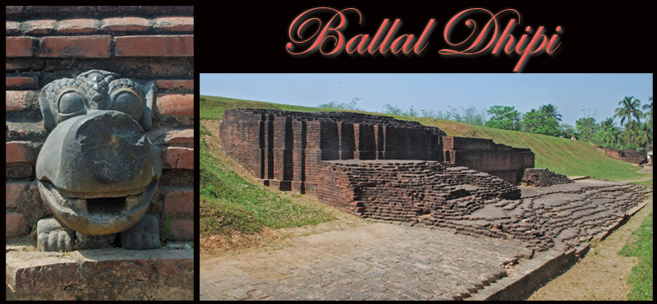
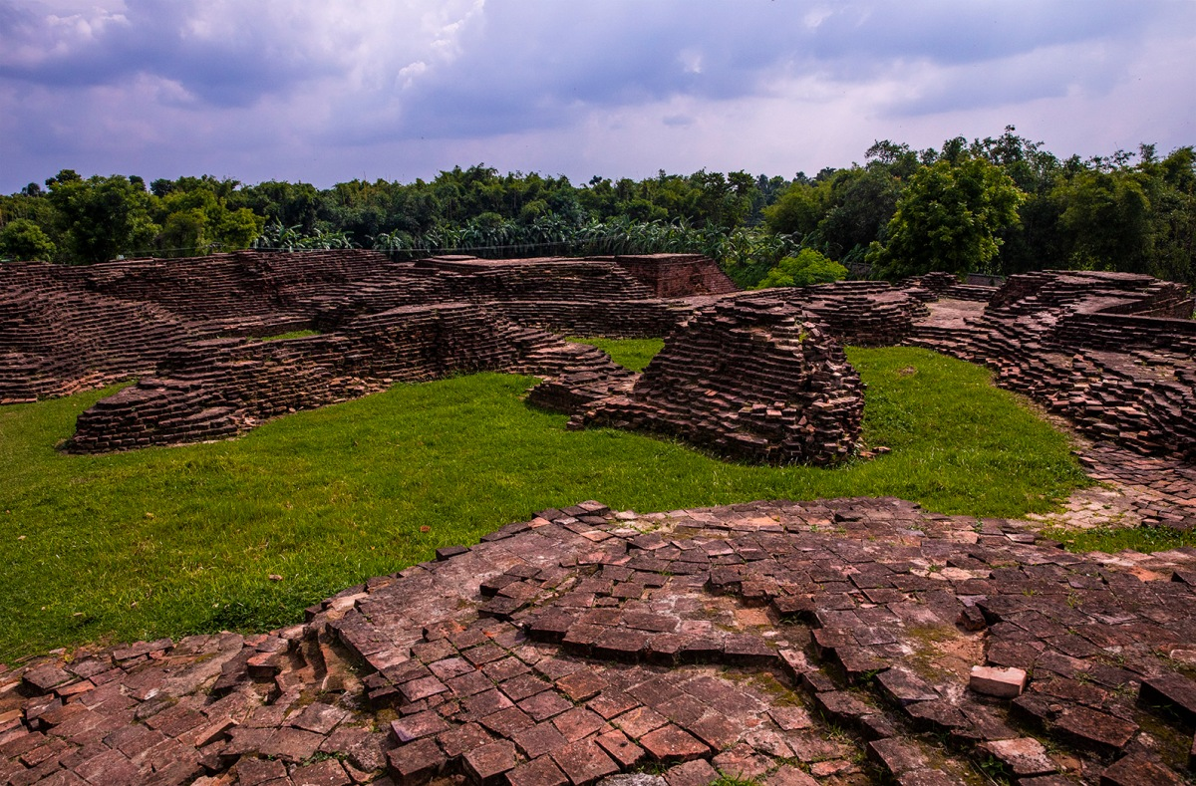
Ballalasena
Ballatasena, the son of Vijayasena, succeeded his father. The dominions he had inherited from his father were kept intact during his generally quiet reign. Ballal Sena conquered Gaur from the Pala, became the ruler of the Bengal Delta, and made Nabadwip the capital as well. Lakshman Sen succeeded Ballal Sena in 1179, ruled Bengal for approximately 20 years, and expanded the Sena Empire to Assam, Odisha, Bihar, and probably Varanasi. In 1203–1204 AD, the Turkic general Bakhtiyar Khilji attacked Nabadwip. Khilji defeated Lakshman Sen and captured northwest Bengal - although Eastern Bengal remained under Sena control.
According to a Sena epigraph, Ballala was an author. He wrote Danasagara in 1168. In 1169, he started but did not finish writing Adbhutasagara. In Adbhutasagara, it was mentioned that Ballala Sena conquered Mithila while Vijaya Sena was still alive. The first is a thorough study of portents and omens, while the second is astronomy. Besides he introduced the practice of Kulinism.

Slide 23
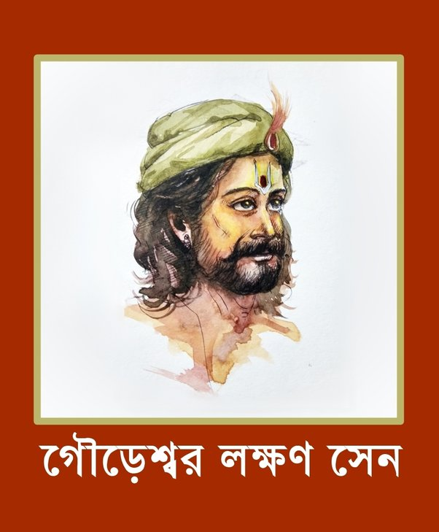
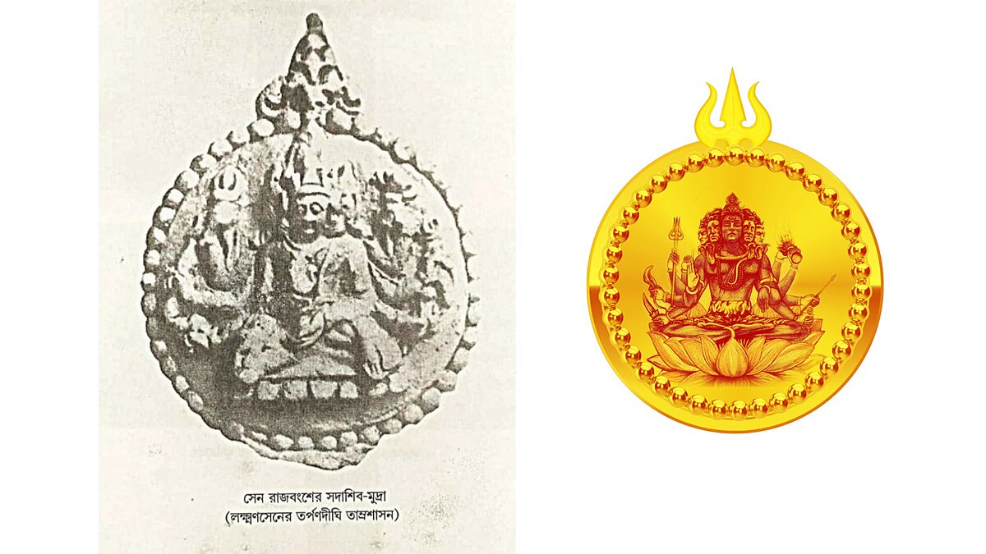
LAKSHMANASENA
Lakshmana Sena (Bengali: লক্ষ্মণ সেন; reign: 1178–1206), also called Lakshman Sen was the last king of the Sen dynasty of Bengal. His reign ended with the invasion of Muhammad bin Bakhtiyar Khilji. He ruled for about 28 years. Lakshmana Sena succeeded his father Ballala Sena. The history of his reign can be reconstructed from the epigraphs of his time so far discovered. Besides the writings of Umapati Dhar, Sharan and the book Tabaqt-i-Nasiri help collect information about him. He was the ruler of the entire Bengal. He defeated King Jaychandra. The capital city of his kingdom was at Bikrampur. He was interested in literature and wrote due part of Adbhut Sagar, a book incompletely written by his father.

Slide 24
SENA ADMINISTRATION
In general, the Pala system of government was maintained under the Senas of Bengal. Even during the Senas, there were still administrative divisions such as Bhuktis, Vishayas, Mandals, etc.
The names Patakas and Chaturakas, are frequently used in inscriptions and literature from the Sena era.
The Sena kings adopted King Aswapati, King Narapati, King Rajaprayadhapati, and others. This suggests that the Senas of Bengal gave greater weight to minor administrative divisions. Bhuktipati, Mandalpati, and Vishayapati are common royal officers. Mahamantri was the new title of the Palas' Prime Minister.
Evidence shows that the Sena monarchs gave their Queen or Rajmahishi land concessions. The Purohitas and Mahapurohitas were also granted land through official grants. This shows how much respect and importance the Purohitas and Mahapurohitas had attained. Under the Senas of Bengal, the Sandhivigrahika of the Palas adopted the appellation Mahasandhivigrahika.
The Senas of Bengal appointed Mahamudradhkrita and Mahasarbadhkrita. The highest judge was also known as Mahadharmadhyakshya. Under the Senas of Bengal, the military officers also adopted new names. In this context, Mahapilupati, Mahaganastha, and Mahabyutpati may be mentioned.
There is a reference to 29 classes of officers under the Senas of Bengal in Iswar Ghosh's copperplate. There have never been so many different classes or grades of officers in independent Bengal. It must be noted that the basic framework of the Palas' governance under the Senas of Bengal remained the same.
During the Sena era, the class of officers known as Pradeshtris, which Kautilya mentions, was also appointed. This demonstrates how the Sena administration was influenced by the Hindu administrative structure.
Last but not least, it must be noted that the Sena era was also one of peace and prosperity in Bengal's history. Society, politics, and religion all saw improvements under the Senas of Bengal.

Slide 25
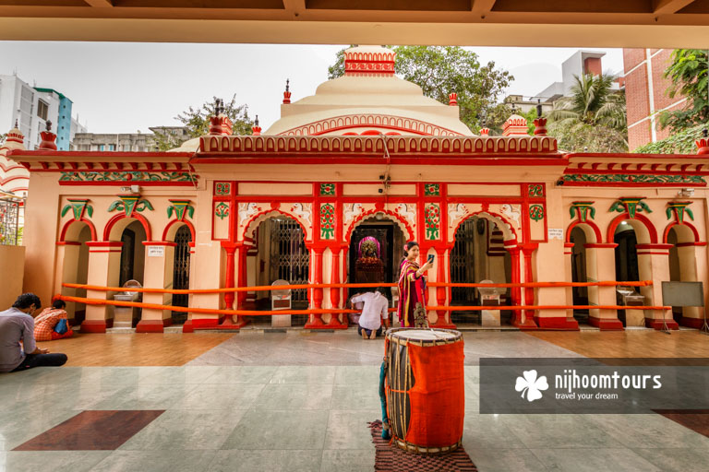
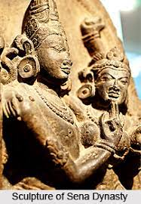
SOCIETY OF SENA DYNASTY
The Sena dynasty is famous for building Hindu temples and monasteries, which include the renowned Dhakeshwari Temple in what is now Dhaka, Bangladesh. In Kashmir, the dynasty also likely built a temple, which is ascribed to Ballala Sena.
The Sena rulers were also great patrons of literature. During the Pala dynasty and the Sena dynasty, major growth in Bengali was witnessed. Some Bengali authors believe that Jayadeva, the famous Sanskrit poet and author of Gita Govinda of Lakshman Sen. After the Sena dynasty, the Deva dynasty ruled in eastern Bengal. The Deva dynasty was probably the last independent Hindu dynasty of Bengal.
The Sena rulers consolidated the caste system in Bengal. Although Bengal borrowed from the caste system of Mithila, caste was not so strong in Bengal as in Mithila.
Many sculptures depicting Hindu gods and goddesses are a part of the creative movement

Slide 26
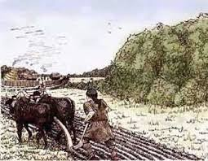
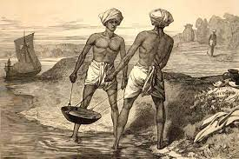
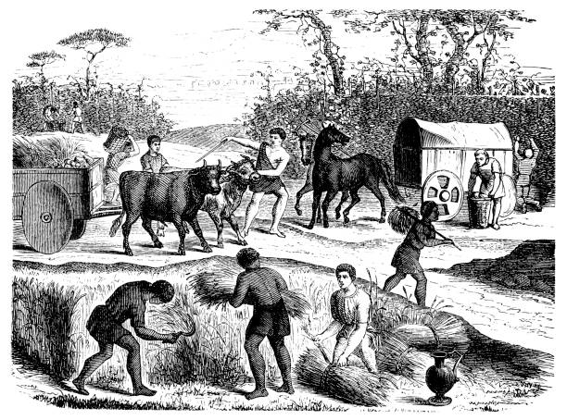
THE ECONOMIC CONDITION OF ANCIENT BENGAL
Bengal is always an agricultural country. Most of the people of Bengal in the ancient time lived-in villages. They would all together build up villages & maintained their families by cultivating the surrounding lands of the villages. Those who cultivated lands or used lands by any means had to pay some specified taxes. the economy of the country was built up depending on agriculture.

Slide 27
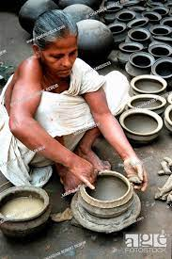
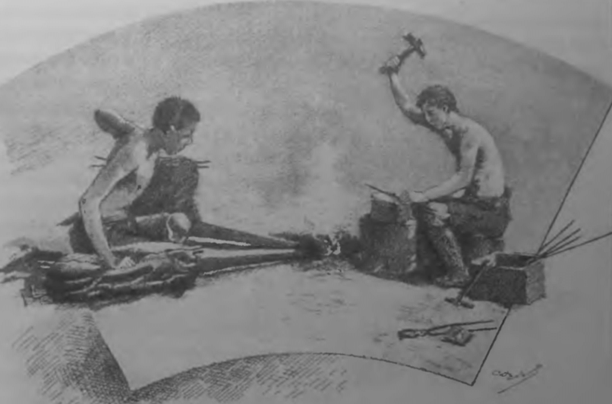
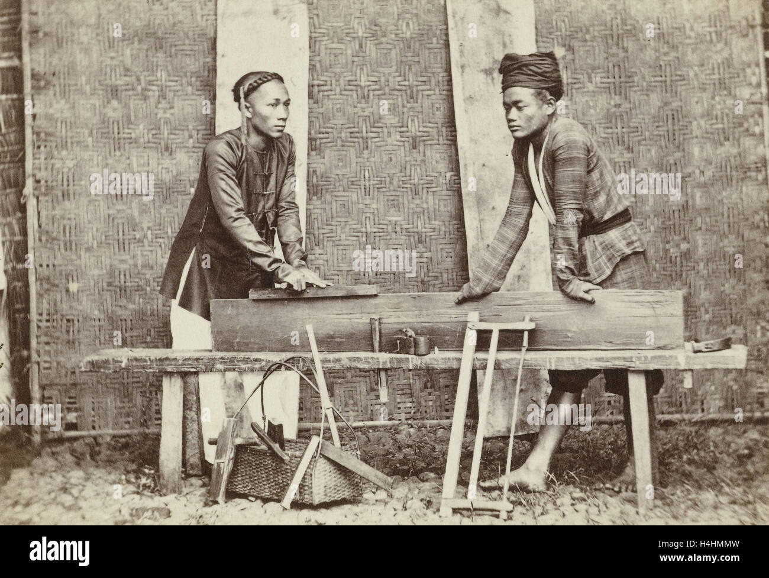
THE ECONOMIC CONDITION OF ANCIENT BENGAL
Ancient Bengal was very rich in cottage industry. Things made of iron were chopper, axe, spade, spud, small spud, plough etc. Besides, water-pot and fighting weapons like arrow, spear, sword etc. were produced. Things made of earth included pitcher, small pitcher-shaped water-pot, large pots for cooking, dishes etc. Gold industry and gems and jewels industry developed very much for luxury things. Wood industry was also very developed. Different types of boat to move in rivers and big boats and ships to move in the sea were made of wood.

Slide 28
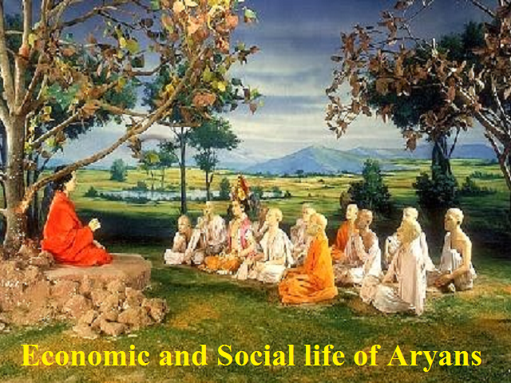
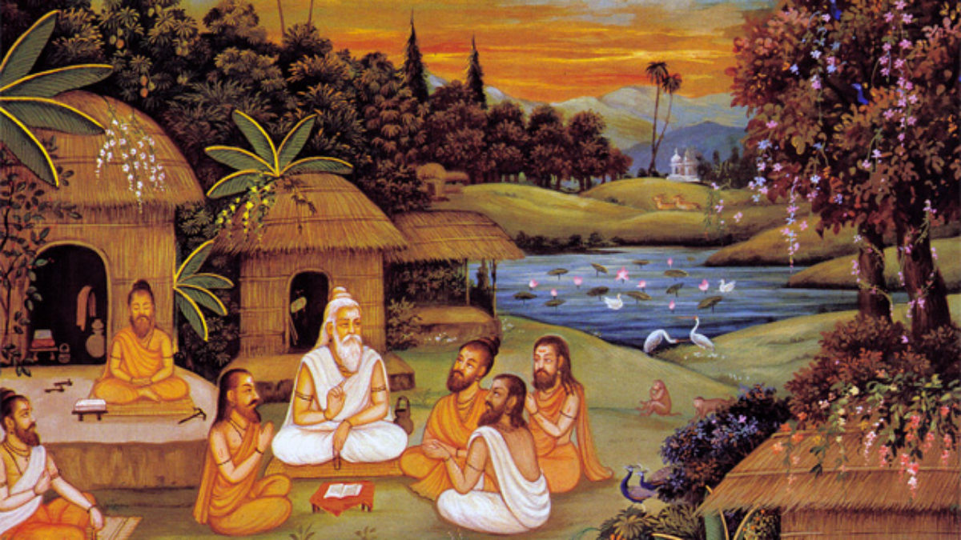
SOCIAL & CULTURAL LIFE IN ANCIENT BENGAL
Before the Maurya rule no political identity grew up in the people of Bengal in a broader Sense. During this time society was divided into different classes. Before the Aryans, some religious thoughts spread into Hinduism in the later periods. Among them remarkable are Karmafal (consequences of one's actions especially of previous birth that governs one's weal and woe), belief in rebirth, practice of yoga etc. The influence of many customs and manners of this age are noticed in Hindu society in the later periods.

Slide 29
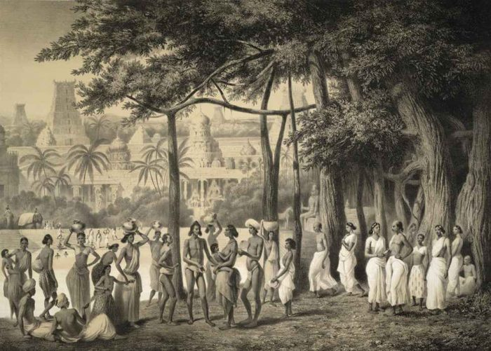
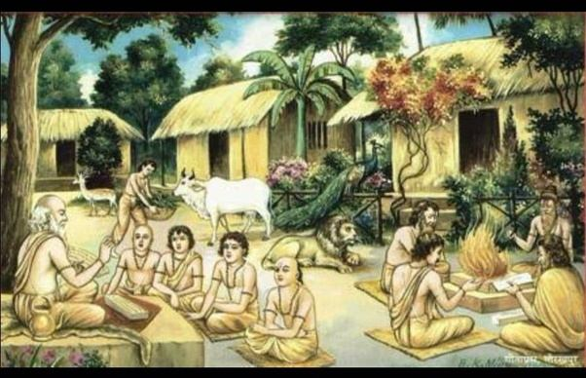
SOCIAL & CULTURAL LIFE IN ANCIENT BENGAL
Everycaste in the society had particular occupation. Studying, teaching and performing religious activities were the jobs of the Brahmins. They would get the highest dignity in the society. The occupation fighting. Trade and commerce were done by the Vaishyas. The Sudras of the lowest class would generally do agricultural work, fishing and other lower jobs. People of all other castes except they would associate with one another. Generally, marriage would take place within the same caste.

Slide 30
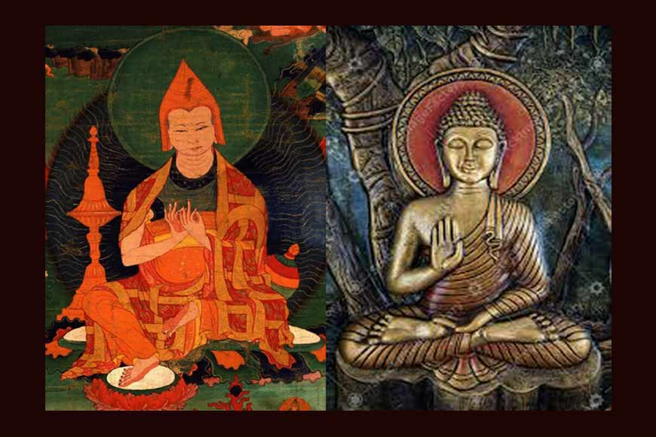
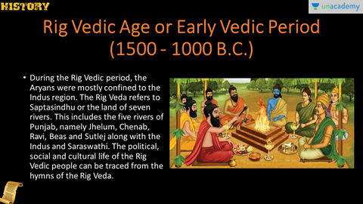
RELIGIOUS CONDITIONS OF ANCIENT BENGAL
Nothing exact can be known which religion was in vogue in ancient Bengal before the establishment of Aryan religion. Because the history of the religious activities of those primitive settlers in the history of worshiping, fear and devotion, beliefs and prejudices of the people of small ethnic communities of country Bengal confined in Janapadas. Then the nature of religion was not the same throughout the country. Rather differences were noticed in religious activities with the differences of castes, classes, Janapad etc. All the same, their ancient religious beliefs, prejudices, methods of worshipping were transformed and mixed with the Aryan religion.

Slide 31
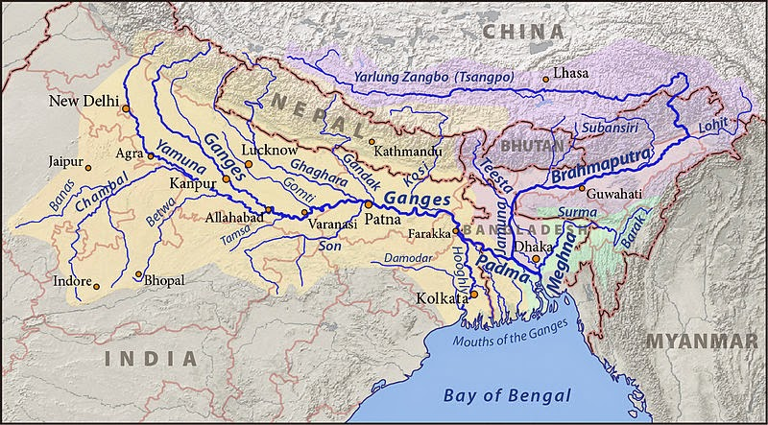
RIVERS & THE SOCIAL-ECONOMIC AND CULTURAL LIFE OF ANCIENT BENGAL
The relationship between rivers and the social, economic, and cultural life of Ancient Bengal is a multifaceted and profound one, with rivers playing a central role in shaping the region's history and development. In this historical review, we will explore how rivers such as the Ganges, Brahmaputra, and Meghna influenced the ancient society, economy, and culture of Bengal.

Slide 32
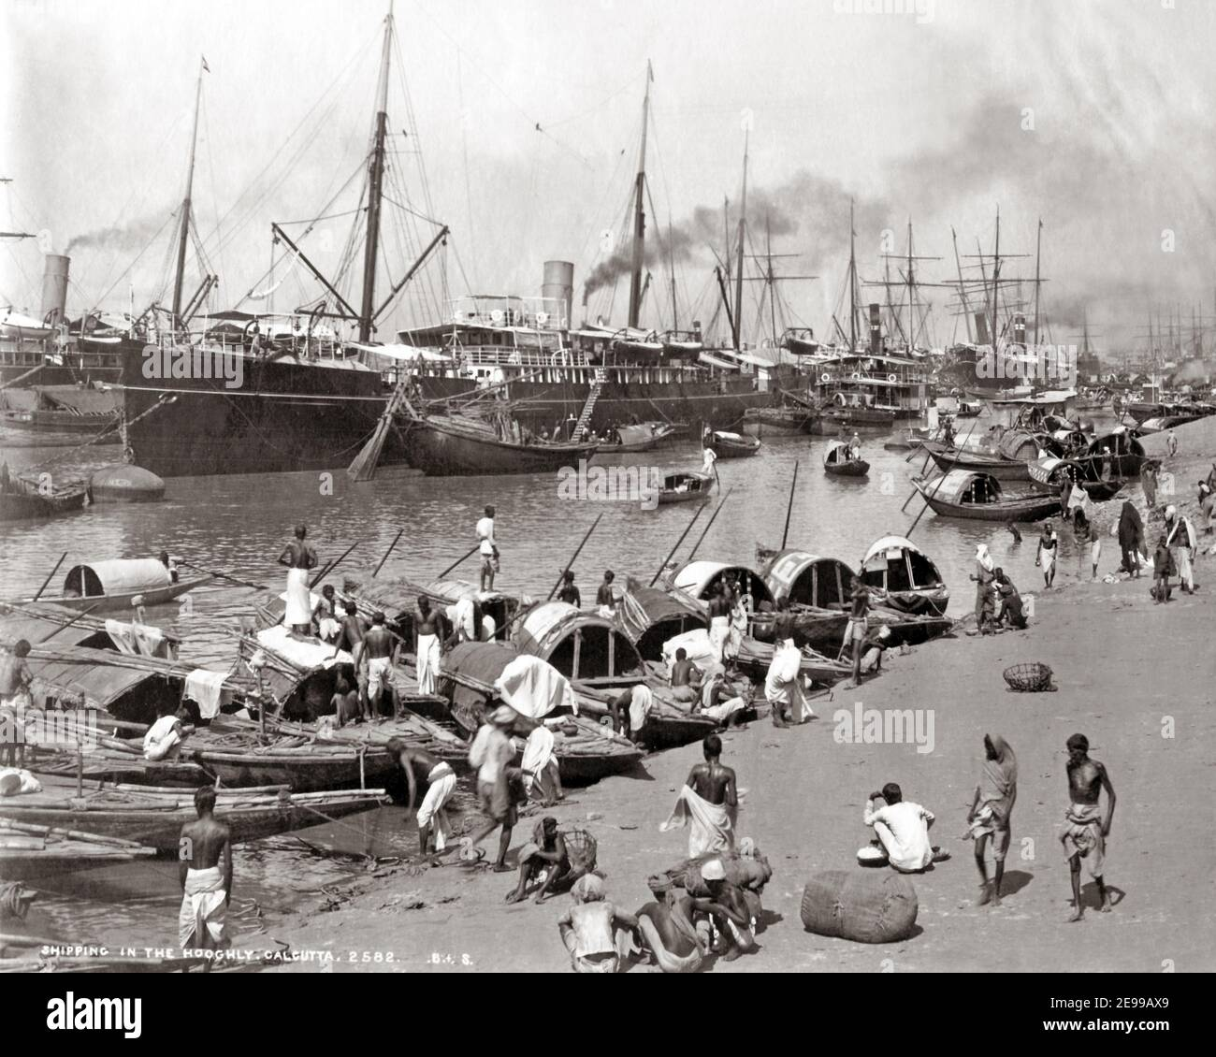
ECONOMIC SIGNIFICANCE
Agriculture: The fertile riverbanks and deltas of Bengal were ideal for agriculture. Ancient Bengal became a rice-producing powerhouse, contributing significantly to the agrarian economy of the Indian subcontinent. The annual flooding of the rivers deposited nutrient-rich silt, ensuring bountiful harvests.
Trade and Commerce: Rivers served as natural trade routes, facilitating the movement of goods and people. Ancient Bengal was strategically positioned on the maritime Silk Road, which connected it to Southeast Asia, China, and the Middle East. Trade along these river routes enriched the region and fostered cultural exchanges.

Slide 33
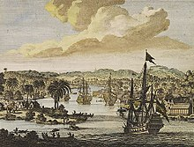
SOCIAL IMPLICATIONS:
Settlement Patterns: The availability of water for irrigation and transportation influenced settlement patterns. Villages and towns sprang up along the riverbanks, forming a dense network of communities. These settlements often had a distinct cultural and social life centered on the river.
Social Hierarchies: Control over-irrigation and access to river resources often led to the emergence of social hierarchies. Those who controlled the water supply held significant power and influence in ancient Bengal's society.

Slide 34

CULTURAL SIGNIFICANCE:
Religion and Rituals: Rivers held immense religious significance in ancient Bengal. The Ganges, in particular, was revered as a sacred river. Pilgrims from across the subcontinent traveled to bathe in its waters, and riverbanks became sites of religious ceremonies and rituals.
Art and Literature: The beauty and symbolism of rivers found expression in art and literature. Ancient Bengali poetry, such as the works of Rabindranath Tagore, often featured the rivers as metaphors for various emotions and experiences.
Festivals: Festivals like Durga Puja, which celebrates the goddess Durga's victory over evil, often involve the immersion of idols in the rivers. This ritual not only signifies the cyclical nature of life but also fosters a sense of community and cultural identity.

Slide 35


